Slide 1
Financial Data Analysis
Matthew Bates & Sankeerti Haniyur

Slide 2
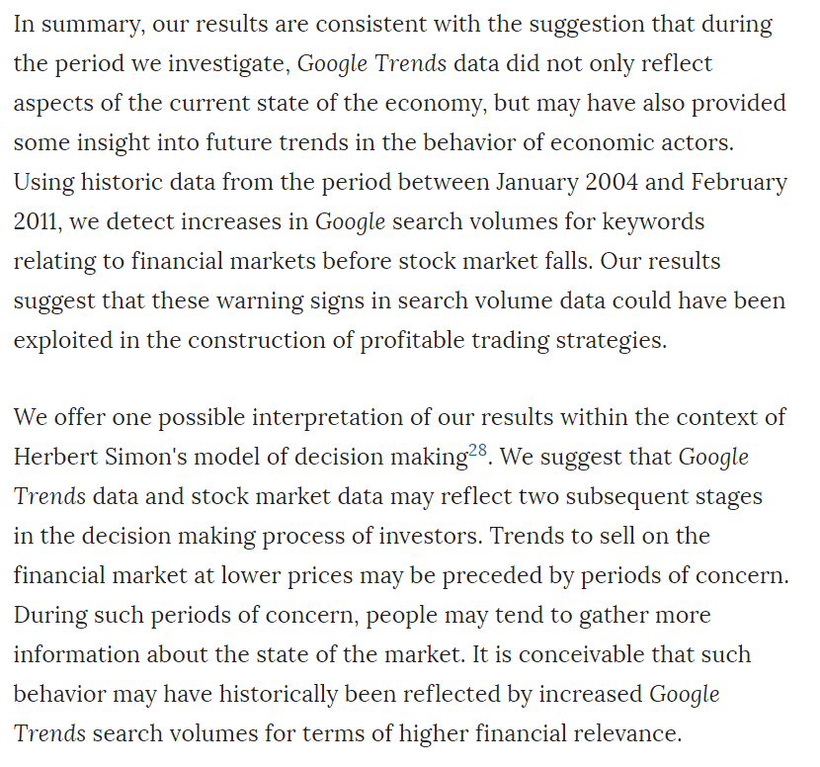
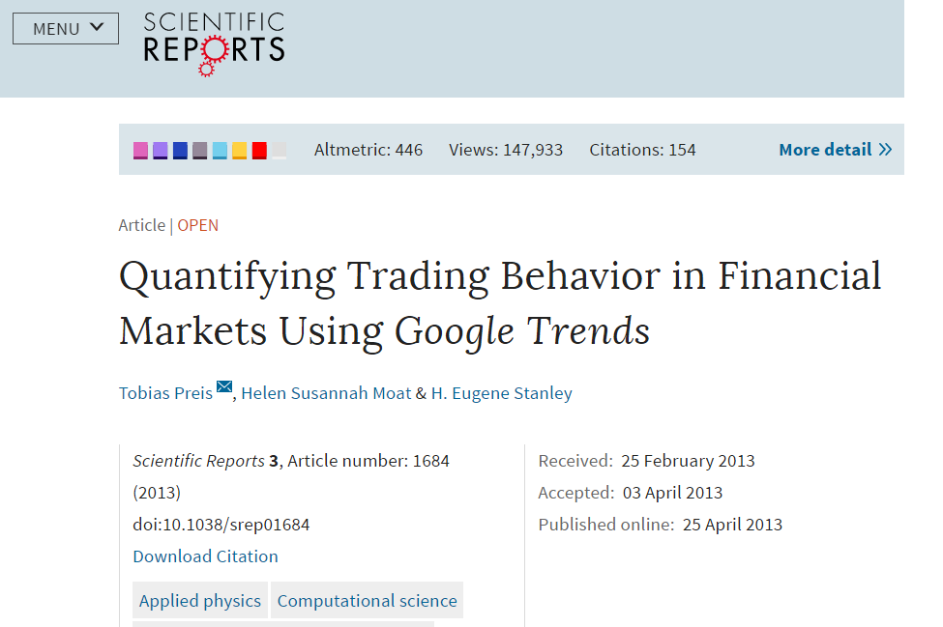
Introduction
Read a few research papers about predicting stock market trends using search engine data
Idea is that an uptake in individuals searching for information related to stock/company losses might foreshadow a stock price drop
Source: "Quantifying Trading Behavior in Financial Markets Using Google Trends" by Tobias Preis, Helen Susannah Moat & H. Eugene Stanley -

Slide 3
Methodology
Calculate weekly averages
Explore
Results
Google Trends
Yahoo Finance
Obtain Data
Manipulate
Correlation between stock price & search results
Determine optimal lags
Calculate returns
Identify weeks with greatest losses
Is this idea viable?

Slide 4
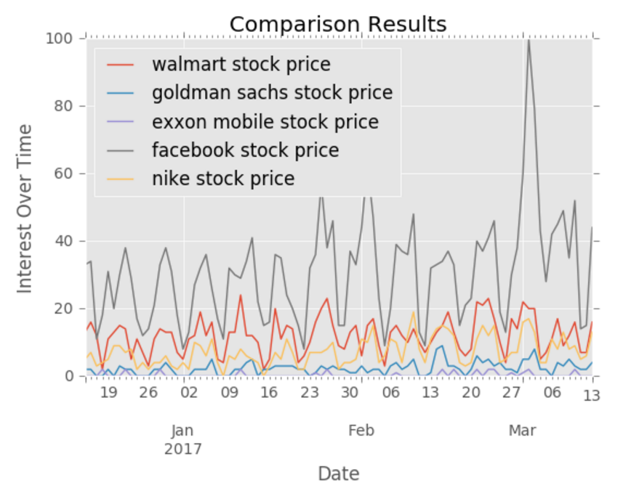
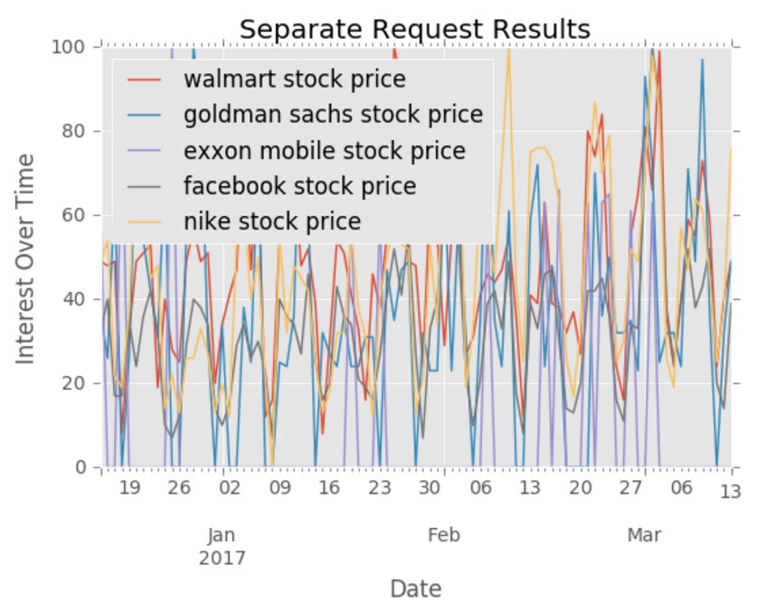
Data: Google Trends
Used an unofficial API – pytrends
Initially observed weekly pattern in data

Slide 5
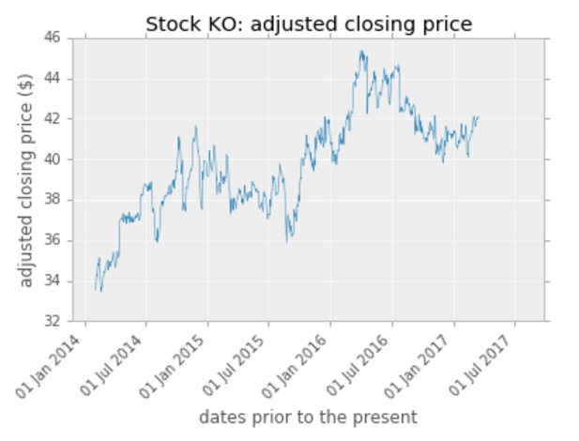
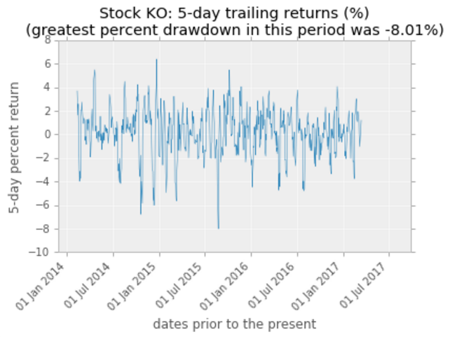
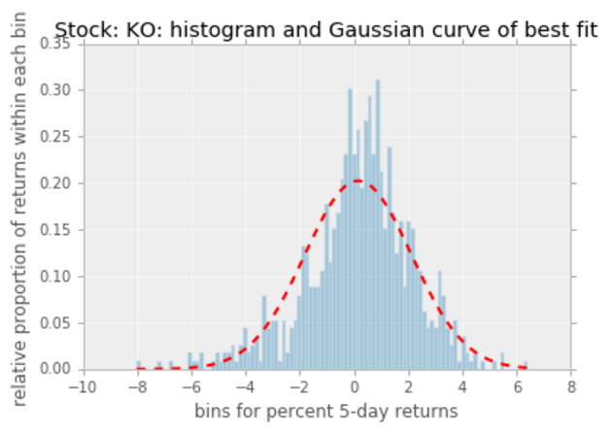
Data: Yahoo Finance
Used lognormal distribution and percent returns to describe stock data
N-day percent trailing returns
Below are results for Coca-Cola, 5-day trailing returns, calculated daily

Slide 6
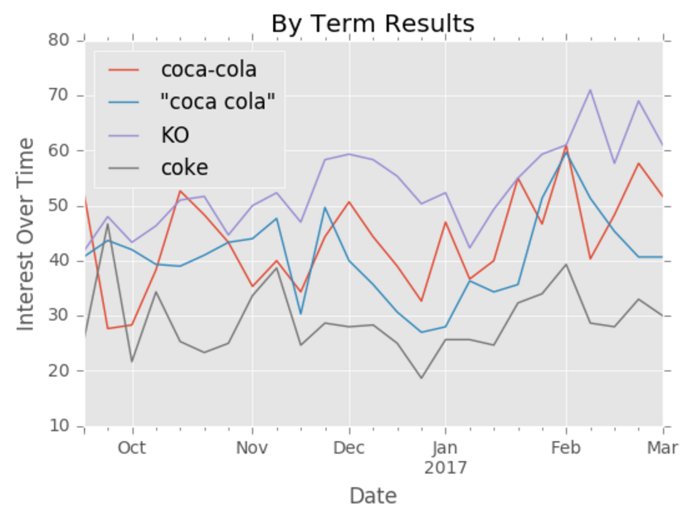
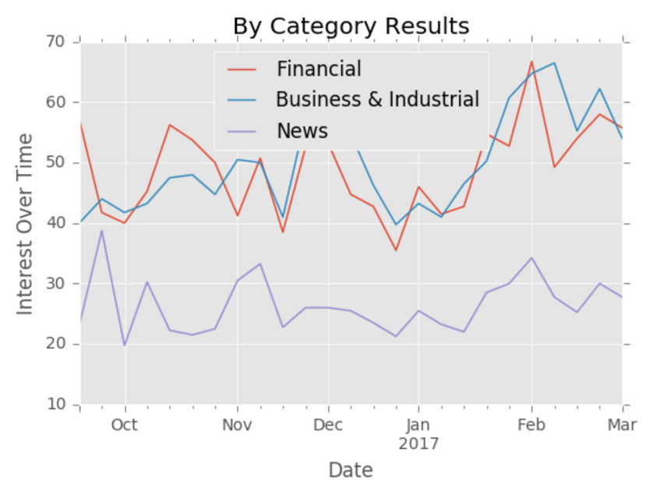
Manipulate: Google Trends
Use weekly data to smooth over weekday vs weekend search frequency spikes
Decided to focus on one company for demonstration: Coca-Cola
Search terms: coca-cola, coca cola, KO, coke
Obtained weekly results per term for last 3 years
3 search-term categories of focus: Financial, Business & Industrial, News

Slide 7
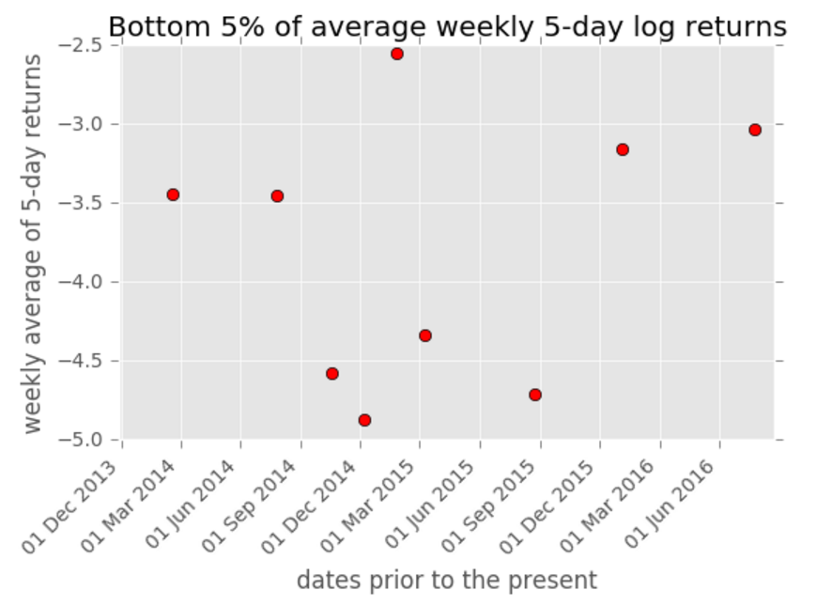
Manipulate: Yahoo Finance
Calculated average returns per week to match Google Trends data
Created a binary time series for only most substantial losses (bottom 5%)
Ex: 0 0 0 0 1 0 0 0 1 0 0

Slide 8
Explore: Cross-Correlation
We calculated the cross-correlation between the two time series: stock returns (now in binary form) and trends data
For each lag, we obtained one correlation number so we could see which lag had the most correlation
Here is the equation:

Slide 9
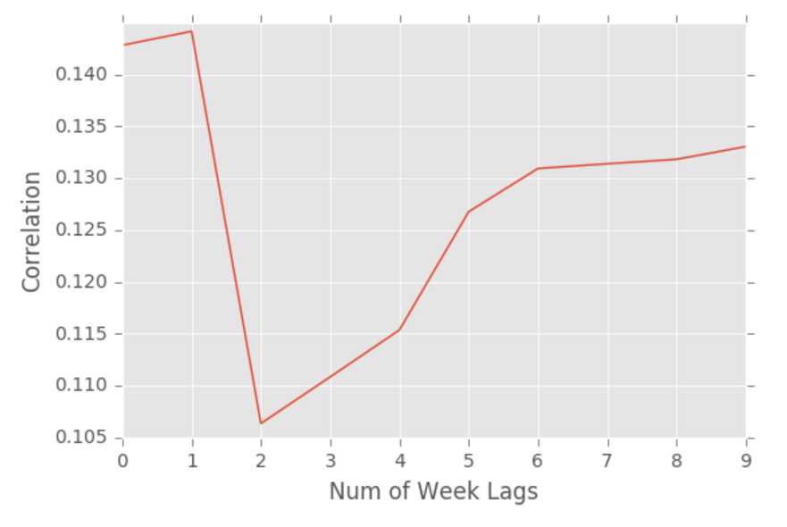
Results
Cross-Correlation Results
Optimal lags are 0 & 1
Highest cross-correlation
Makes sense since we cannot predict something that will happen 3 weeks from now
Interesting that the later lags have high correlation too…

Slide 10
Further Steps
Try this for other stocks in various industries
Is the optimal number of lags the same?
Maybe take 3-4 day averages rather than weekly averages to get more detailed results
Sell our project to investment banks ;)

Slide 11
Thank You!
Any questions?

